Slide 1

Unveiling the Voice of the Customers Sentiment Analysis of E-commerce Product Reviews
Presented By
Pratik Kadam
PGA WE 07

Slide 2
With public sentiment
nothing can Fail,
Without it,
nothing can succeed.

Slide 3
Outline
Introduction
Objective
What is Sentiment Analysis?
Why is Sentiment Analysis Important?
Process Flow
NLP and Sentiment Analysis
Challenges of Sentiment Analysis in E-commerce

Slide 4
Introduction
Welcome everyone! Today, we're going to talk about something that affects all of us as consumers : sentiment analysis.
“Have you ever looked at customer reviews before making a purchase?”
Of course you have! We all have. And that's where sentiment analysis comes in.
Sentiment analysis is the process of analyzing customer reviews to determine the overall sentiment towards a product or service.
It's becoming important for businesses to use sentiment analysis to improve their customer satisfaction and sales.
But how does it work? That's what we're going to explore today.

Slide 5
What we are going to do?
Develop an advanced Sentiment Analysis model using Natural Language Processing (NLP) techniques and Machine Learning to accurately classify text data into sentiment categories, providing valuable insights for businesses and organizations to understand and respond to customer opinions effectively.

Slide 6
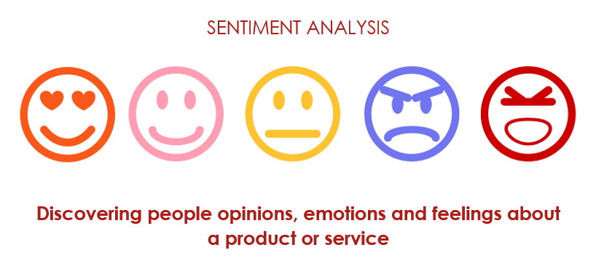
What is Sentiment Analysis?
Sentiment analysis is a technique that helps computers understand and interpret emotions from text data.
Also Know as Opinion Mining.
Sentiment analysis helps computers understand how people feel about a particular topic, product, or service.
It's widely used to analyze customer feedback, social media content, reviews, and more.
Source: https://www.upgrad.com

Slide 7

Why Sentiment Analysis is Important?
Sentiment analysis is crucial for E-commerce websites and businesses.
It helps them understand customer feedback and improve their products and services accordingly.
By analyzing customer reviews, sentiment analysis can identify common issues and help businesses to address them.
Source: https://solutionshub.epam.com

Slide 8




Tools Used
Platform / Tool : Jupyter Notebook, Google Chrome
Library Used : Scikit-learn, Pandas, Numpy
Language: Python

Slide 9
Process Flow
Research/
Study
Data Collection
Exploratory Data Analysis
Conclusion
Model Building
Data Visualization

Slide 10
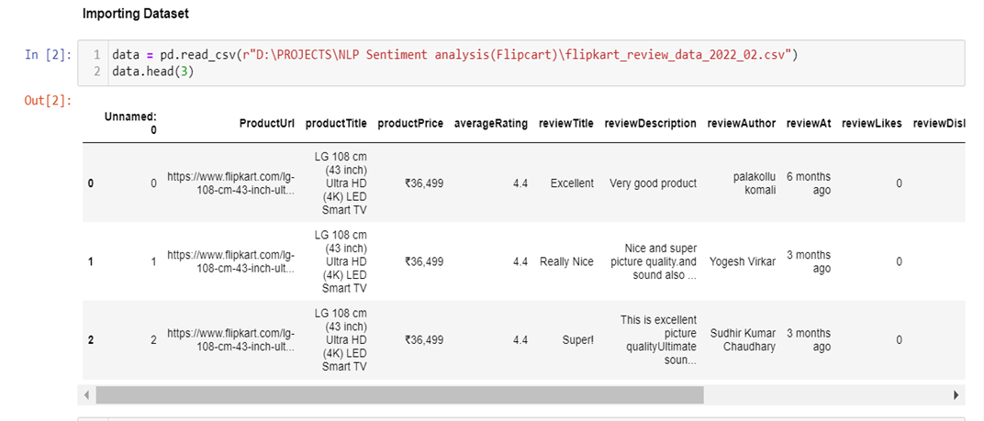
Data Collection
Columns Names :
1) Unnamed: 0 2) ProductUrl 3) productTitle 4) productPrice 5)averageRating 6) reviewTitle 7) reviewDescription 8)reviewAuthor 9) reviewAt 10) reviewLikes 11) reviewDislikes 12) certifiedBuyer 13)reviewerLocation 14) scrapedAt 15) uniquids.

Slide 11
Dataset contains 3 Products data :
LG 108 cm (43 inch) Ultra HD (4K) LED Smart TV
MOTOROLA Revou-Q 139 cm (55 inch) QLED Ultra HD (4K) Smart Android TV with Wireless Gamepad
MOTOROLA Revou-Q 127 cm (50 inch) QLED Ultra HD (4K) Smart Android TV with Wireless Gamepad
Rows: 343
Columns: 15

Slide 12
2. Exploratory Data Analysis/ Data Cleaning
Steps :
1) Lower Case
2) Removing URL
3) Removing Punctuations
4) Removing Numbers
5) Removing Stopwords
6) Stemming/Lemmitization
7) Removing Extra white space

Slide 13
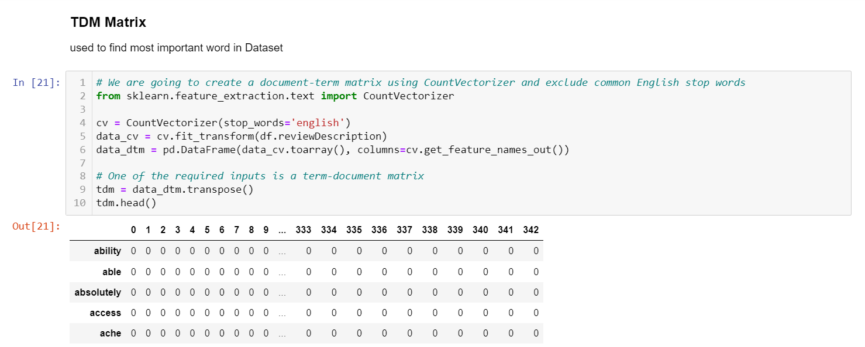
Term-Document Matrix is used to find the most important word in Dataset

Slide 14
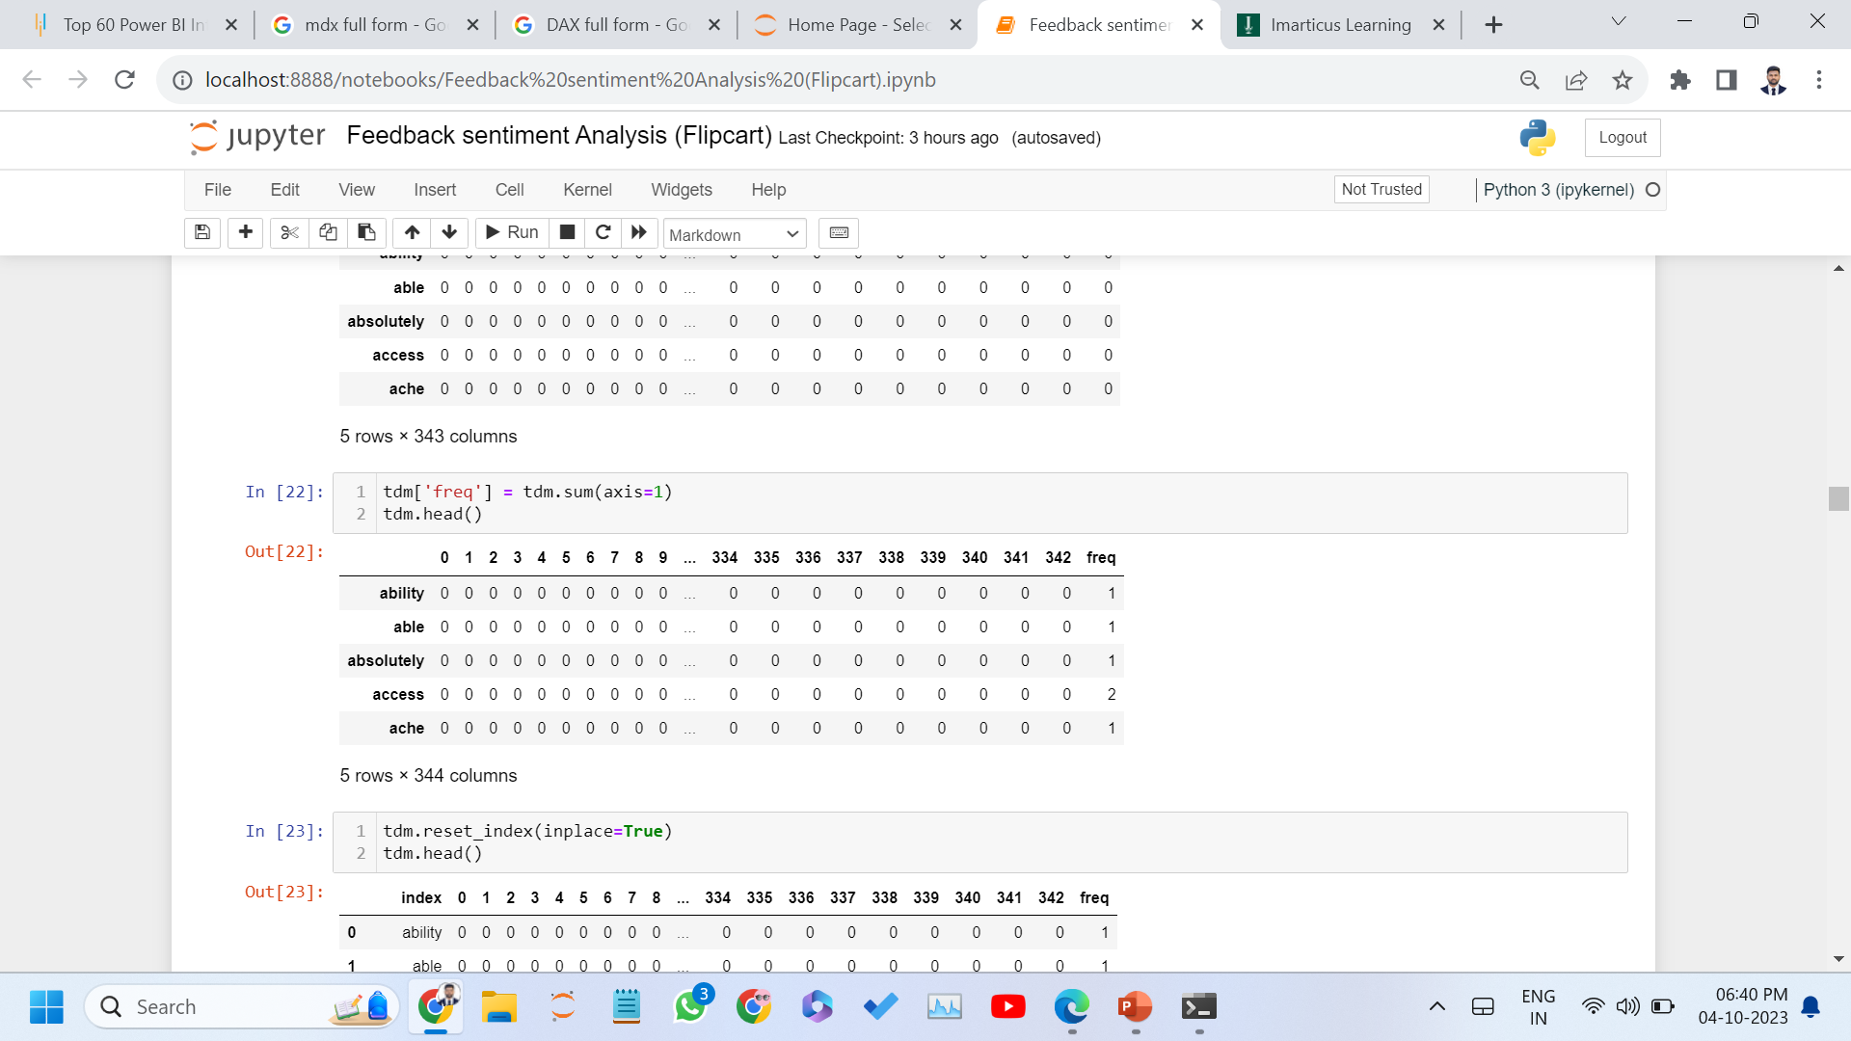
Measuring frequency of each word

Slide 15
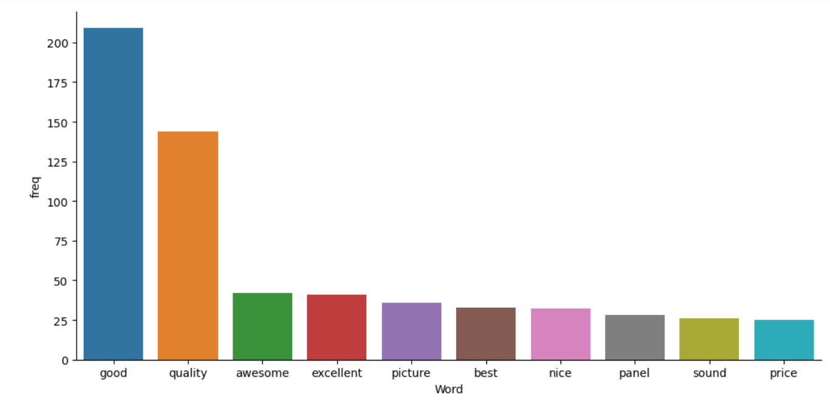
Data Visualization Frequency wise Graphical Representation of Words

Slide 16
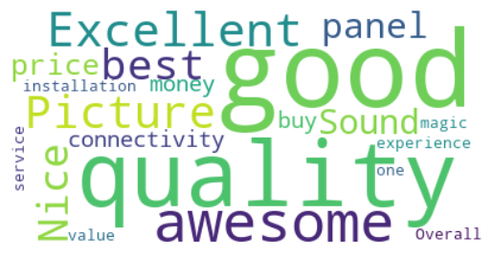
Wordcloud

Slide 17
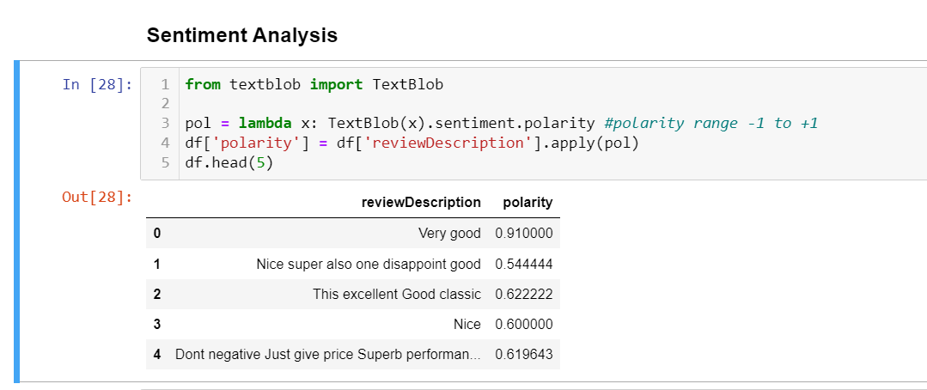
Sentiment Analysis
Using Textblob library each documents Polarity is calculated.
Polarity range -1 to +1.
-1 = Negative, +1 = Positive

Slide 18
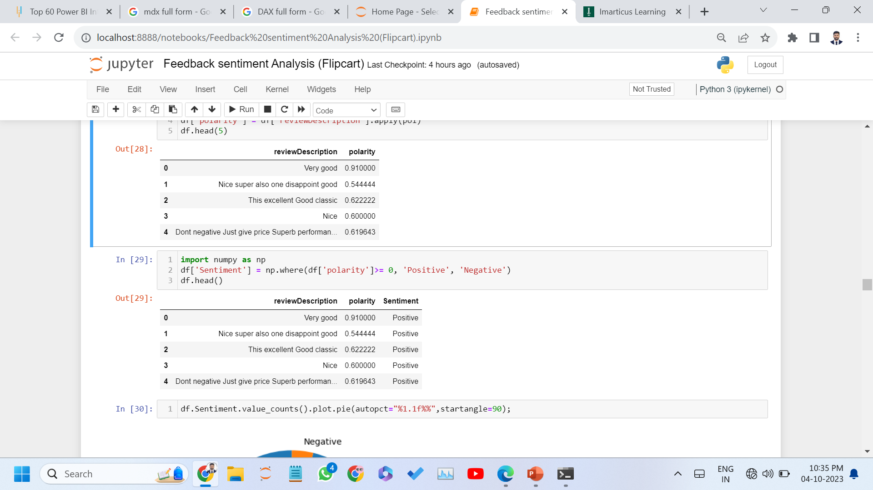

Slide 19
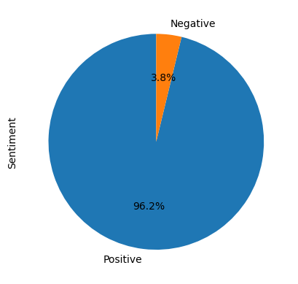
Graphical Representation of Sentiment

Slide 20
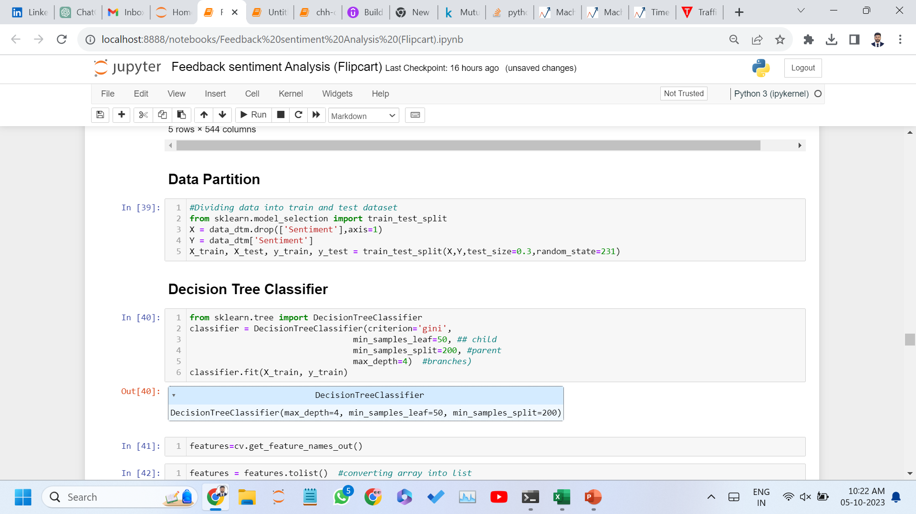
7. Model Building
Data Partition : Train data 70% , Test Data 30%

Slide 21
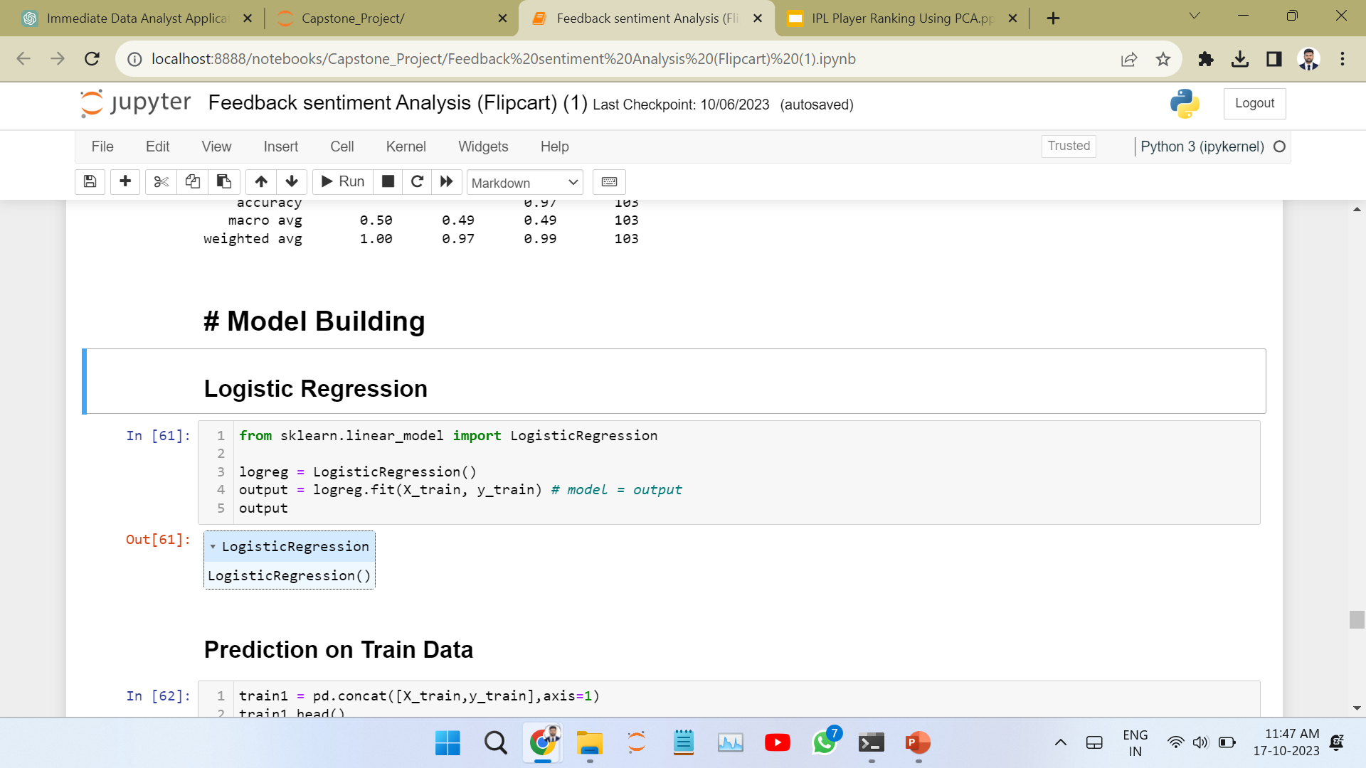
Logistic Regression Imported Logistic Regression classifier from sklearn library

Slide 22
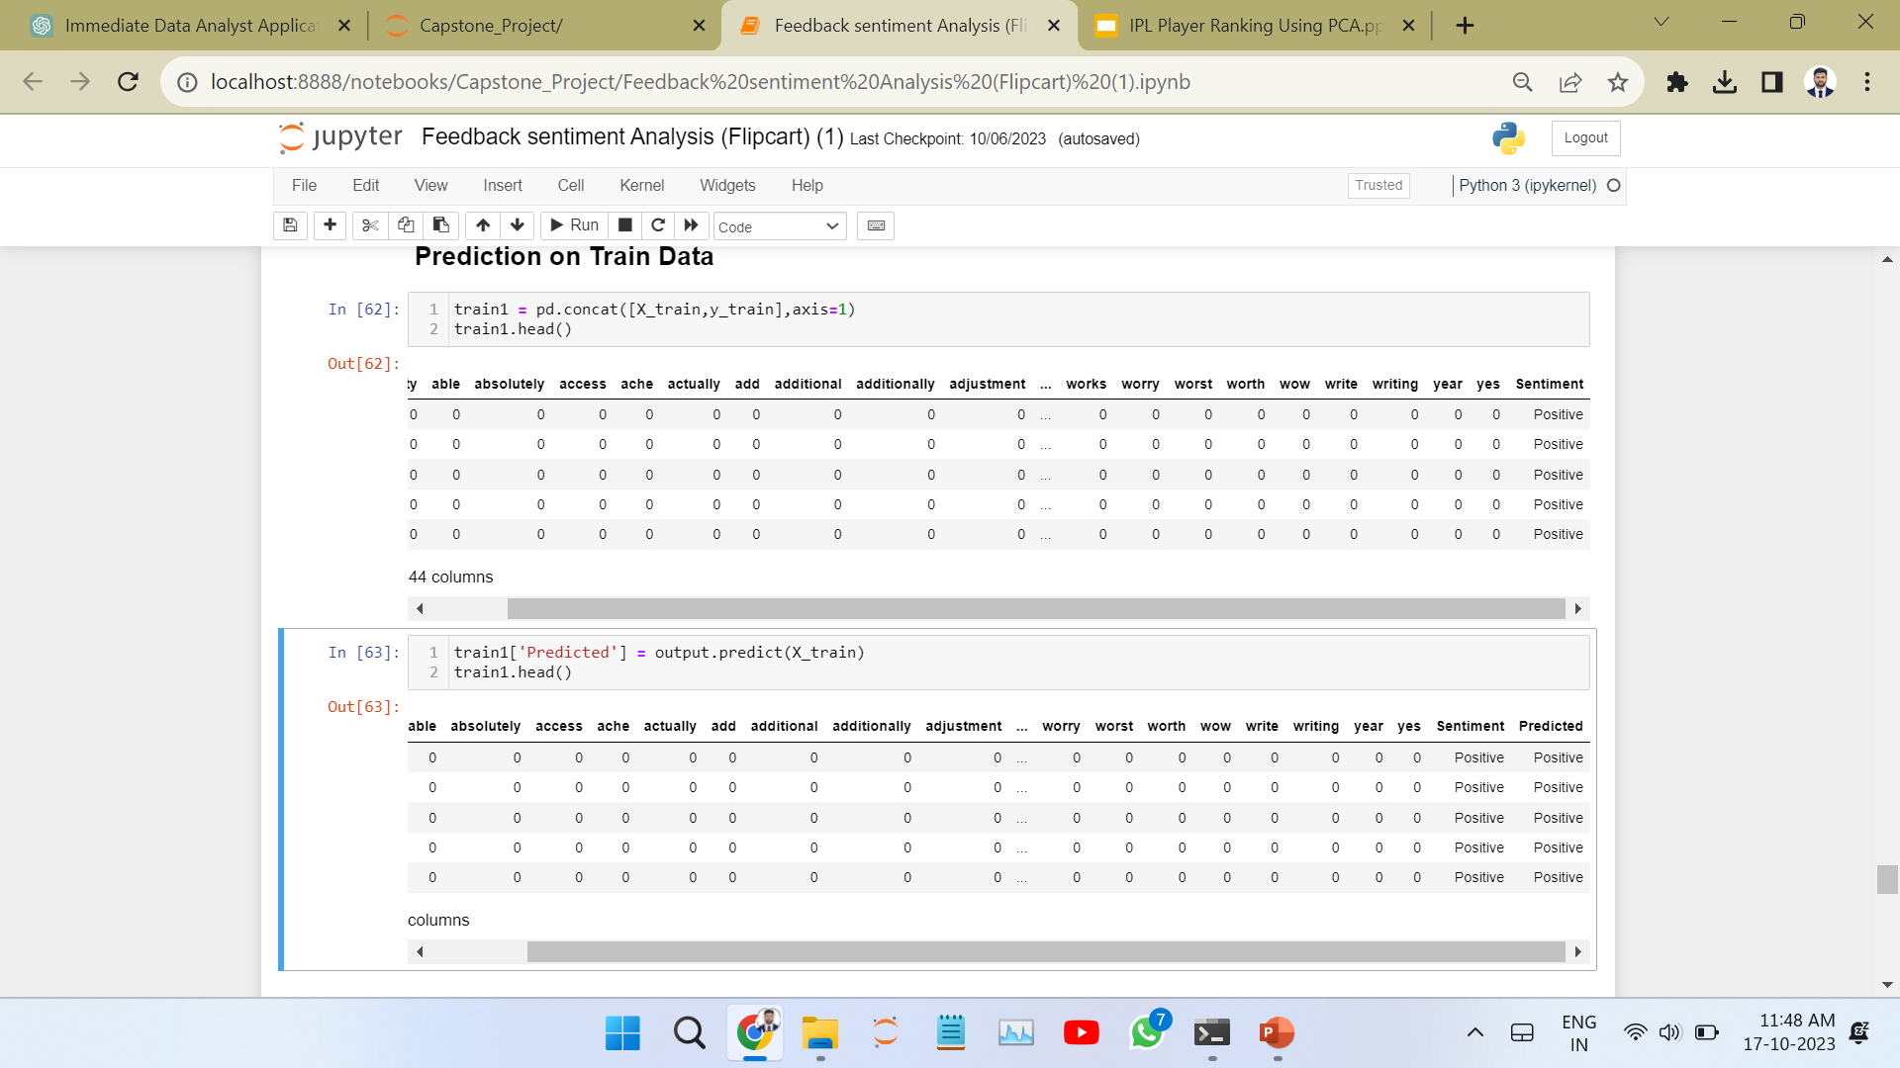
Prediction on Train Data Combined X_train and y_train and for prediction added new column “Predicted”

Slide 23
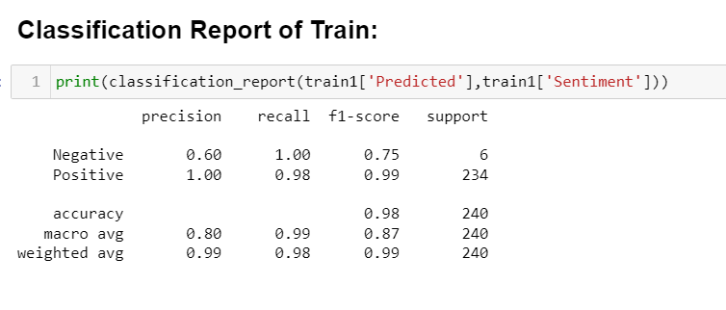
Train Data Accuracy is 0.98 (98%) ,Model is Good Fit. We can apply it on Test Data

Slide 24
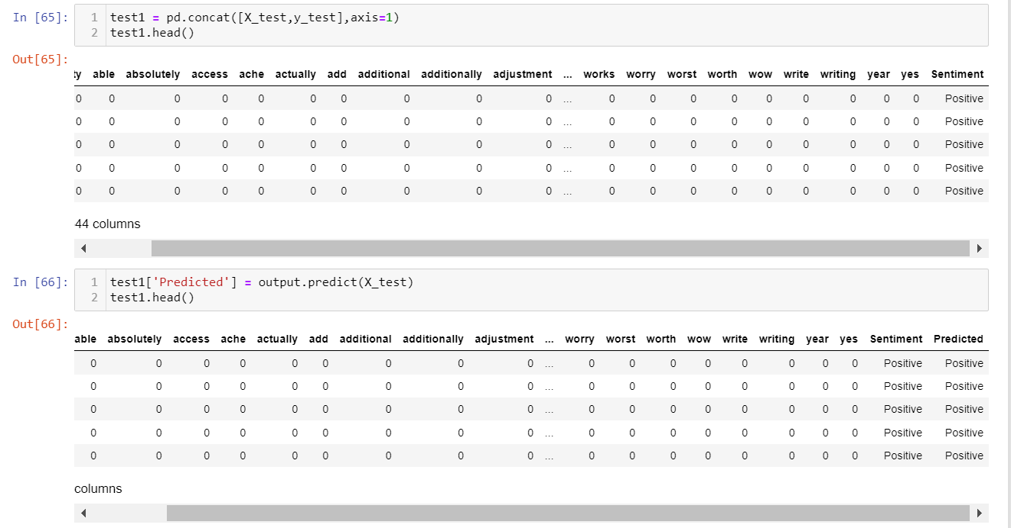
Prediction on Test Data combined X_test and y_test and for prediction added new column “Predicted”

Slide 25
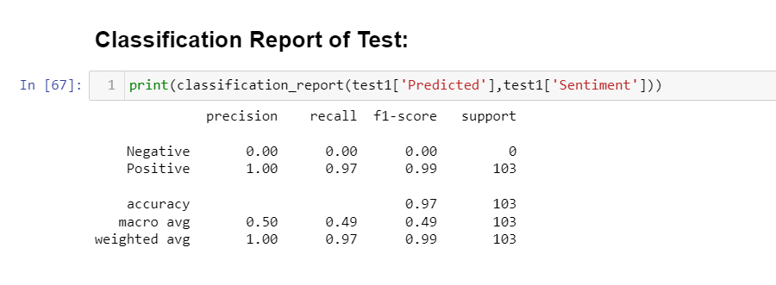
Model Accuracy is 97%

Slide 26
Conclusion
Model Performance: The accuracy of Model is 97%, demonstrating its effectiveness in classifying sentiment in customer reviews.
Key Features: The analysis identified that certain keywords or phrases such as Good, Quality, Awesome, Excellent strongly influenced sentiment classification.
Real-world Application: This sentiment analysis can be valuable to businesses for enhancing products, services and customer satisfaction by gaining insights from customer feedback.
Future Work: Future work could involve exploring more advanced machine learning techniques, gathering additional data sources.

Slide 27
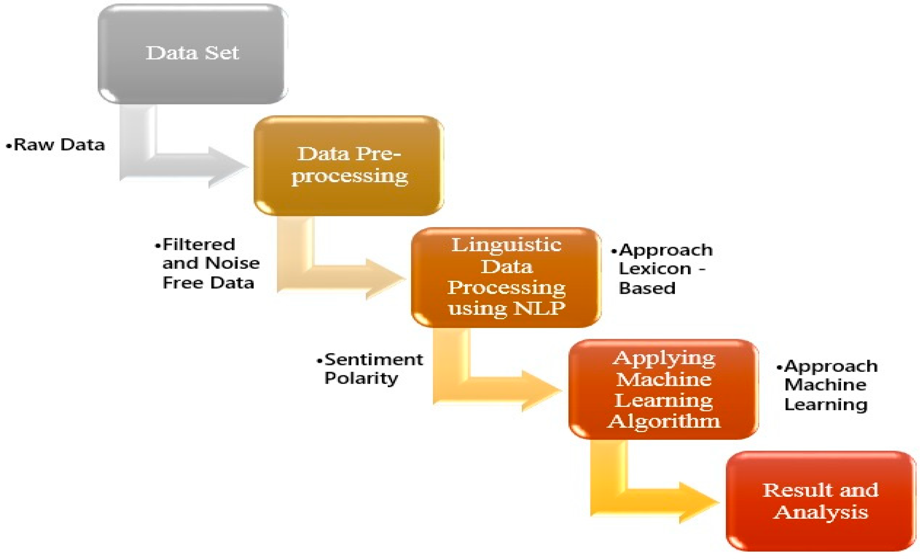
Source : https://www.mdpi.com

Slide 28
NLP and Sentiment Analysis
Natural Language Processing (NLP) is a subfield of computer science that focuses on the interaction between computers and humans through natural language.
NLP is used to analyze and understand the sentiment behind customer reviews.
NLP techniques are used to extract meaningful insights from large volumes of text data.
By analyzing the sentiment behind customer reviews, businesses can gain valuable insights into customer satisfaction and make data-driven decisions to improve their products and services.

Slide 29
Challenges of Sentiment Analysis
Ambiguity: Sentences can have multiple meanings, making it challenging to determine the exact sentiment.
Sarcasm and Irony: Detecting sarcasm and irony in text can be difficult for machines.
Negation: Phrases like "not bad" can be tricky to interpret correctly, as they negate the sentiment.
Emojis and Emoticons: Understanding the sentiment expressed through emojis and emoticons can be complex.
Short Texts: Social media posts and text messages often contain very short and informal language, making it challenging to discern sentiment accurately.
Real-time Analysis: Analyzing sentiment in real-time, such as during live events, can be challenging due to the need for speed and accuracy.

Slide 30
Any Question?
Thank You…

